Slide 1
Network+ Guide to Networks 7th Edition
Chapter 1
An Introduction to Networking
Notes:
Network+ Guide to Networks 7th Edition
Chapter 1
An Introduction to Networking

Slide 2
Objectives
Identify types of applications and protocols used on a network
Distinguish between the client-server and peer-to-peer models used to control access to a network
Describe various networking hardware devices and the most common physical topologies
Notes:
Objectives
Identify types of applications and protocols used on a network
Distinguish between the client-server and peer-to-peer models used to control access to a network
Describe various networking hardware devices and the most common physical topologies

Slide 3
Objectives
Describe the seven layers of the OSI model
Explore best practices for safety when working with networks and computers
Describe the seven-step troubleshooting model for solving a networking problem
Notes:
Objectives
Describe the seven layers of the OSI model
Explore best practices for safety when working with networks and computers
Describe the seven-step troubleshooting model for solving a networking problem

Slide 4
How Networks Are Used
Network services - the resources a network makes available to its users
Includes applications and the data provided by these applications
Types of applications found on most networks:
Client-Server
File and Print Services
Communications Services
Notes:
How Networks Are Used
Network services - the resources a network makes available to its users
Includes applications and the data provided by these applications
Types of applications found on most networks:
Client-Server
File and Print Services
Communications Services

Slide 5
Client-Server Applications
Client computer requests data or a service from a second computer, called the server
List of several popular client-server applications:
Web service
Email services
FTP service
Telnet service
Remote Desktop
Remote applications
Notes:
Client-Server Applications
Client computer requests data or a service from a second computer, called the server
List of several popular client-server applications:
Web service
Email services
FTP service
Telnet service
Remote Desktop
Remote applications

Slide 6
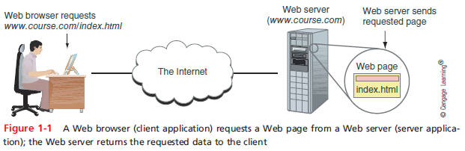
Client-Server Applications
Notes:
Client-Server Applications

Slide 7
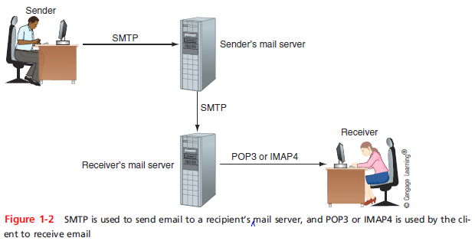
Client-Server Applications
Notes:
Client-Server Applications

Slide 8
File and Print Services
File services - a server’s ability to share data files and disk storage space
File server - a computer that provides file services
Print services - ability to share printers across a network
With one printer, less time is spent on maintenance and management
Notes:
File and Print Services
File services - a server’s ability to share data files and disk storage space
File server - a computer that provides file services
Print services - ability to share printers across a network
With one printer, less time is spent on maintenance and management

Slide 9
Communication Services
Convergence - using the same network to deliver multiple types of communications services
Unified communication (UC) - refers to the centralized management of multiple network-based communications
Three types of communication services:
Conversational voice - VoIP (Voice over IP)
Streaming live audio and video
Streaming stored audio and video
Notes:
Communication Services
Convergence - using the same network to deliver multiple types of communications services
Unified communication (UC) - refers to the centralized management of multiple network-based communications
Three types of communication services:
Conversational voice - VoIP (Voice over IP)
Streaming live audio and video
Streaming stored audio and video

Slide 10
Communication Services
Voice and video transmissions are delay-sensitive
You don’t want to hear or see breaks in transmission
Voice and video transmission are considered loss-tolerant
Network administrators must pay attention to the quality of service (QoS) a network provides for voice and video
Bandwidth - the amount of traffic, or data transmission activity, on the network
Notes:
Communication Services
Voice and video transmissions are delay-sensitive
You don’t want to hear or see breaks in transmission
Voice and video transmission are considered loss-tolerant
Network administrators must pay attention to the quality of service (QoS) a network provides for voice and video
Bandwidth - the amount of traffic, or data transmission activity, on the network

Slide 11
Controlling Network Access
Topology - how parts of a whole work together
Physical topology - mostly applies to hardware and describes how computers, other devices, and cables fir together to form the physical network
Logical topology - has to do with software and describes how access to the network is controlled
How users and programs initially gain access to the network
Network operating system - controls access to the entire network
Required by client-server models
Notes:
Controlling Network Access
Topology - how parts of a whole work together
Physical topology - mostly applies to hardware and describes how computers, other devices, and cables fir together to form the physical network
Logical topology - has to do with software and describes how access to the network is controlled
How users and programs initially gain access to the network
Network operating system - controls access to the entire network
Required by client-server models

Slide 12
Peer-to-Peer Model
Peer-to-peer (P2P) network model - the OS of each computer on the network is responsible for controlling access to its resources
No centralized control
Computers, called nodes or hosts, form a logical group of computers and users
May share resources
May prevent access to resources
Each computer user has a Windows local account
Works only on that one computer
Notes:
Peer-to-Peer Model
Peer-to-peer (P2P) network model - the OS of each computer on the network is responsible for controlling access to its resources
No centralized control
Computers, called nodes or hosts, form a logical group of computers and users
May share resources
May prevent access to resources
Each computer user has a Windows local account
Works only on that one computer

Slide 13
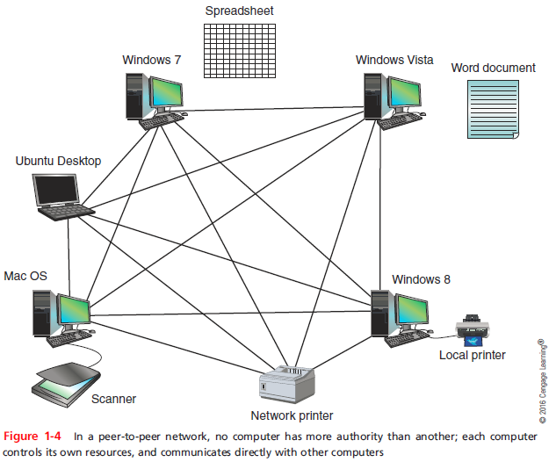
Peer-to-Peer Model
Notes:
Peer-to-Peer Model

Slide 14
Peer-to-Peer Model
Advantages
Simple configuration
Less expensive
Compared to other network models
Disadvantages
Not scalable
Not necessarily secure
Not practical for large installations
Notes:
Peer-to-Peer Model
Advantages
Simple configuration
Less expensive
Compared to other network models
Disadvantages
Not scalable
Not necessarily secure
Not practical for large installations

Slide 15
Client-Server Network Model
Resources are managed by the network operating system (NOS) via a centralized directory database
Windows domain - a logical group of computers that a Windows Server can control
Active Directory (AD) - the centralized directory database that contains user account information and security for the entire group of computers
Global account (a.k.a. global username or network ID) - a domain-level account assigned by the network administrator and is kept in AD
Notes:
Client-Server Network Model
Resources are managed by the network operating system (NOS) via a centralized directory database
Windows domain - a logical group of computers that a Windows Server can control
Active Directory (AD) - the centralized directory database that contains user account information and security for the entire group of computers
Global account (a.k.a. global username or network ID) - a domain-level account assigned by the network administrator and is kept in AD

Slide 16
Client-Server Network Model
A user can sign on to the network from any computer on the network and gain access to the resources that AD allows
This process is managed by Active Directory Domain Services (AD DS)
Clients don’t share their resources directly with each other
Access is controlled by entries in the centralized domain database
Notes:
Client-Server Network Model
A user can sign on to the network from any computer on the network and gain access to the resources that AD allows
This process is managed by Active Directory Domain Services (AD DS)
Clients don’t share their resources directly with each other
Access is controlled by entries in the centralized domain database

Slide 17
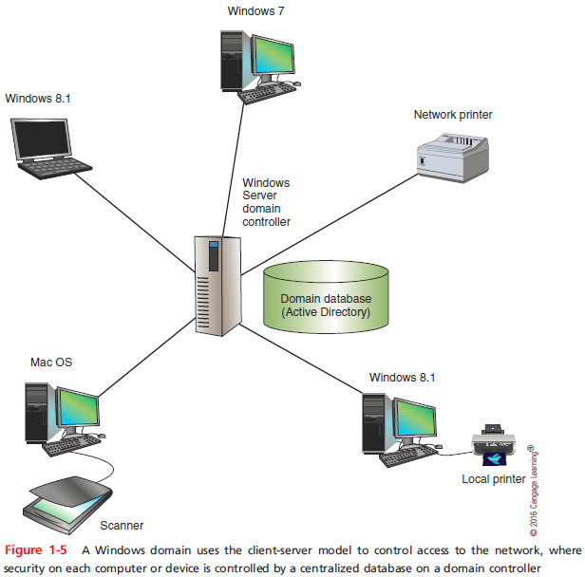
Client-Server Network Model
Notes:
Client-Server Network Model

Slide 18
Client-Server Network Model
The NOS is responsible for:
Manages client data, resources
Ensures authorized user access
Controls user file access
Restricts user network access
Dictates computer communication rules
Supplies application to clients
Server examples
Windows Server 2012 R2, Ubuntu Server, or Red Hat Linux
Notes:
Client-Server Network Model
The NOS is responsible for:
Manages client data, resources
Ensures authorized user access
Controls user file access
Restricts user network access
Dictates computer communication rules
Supplies application to clients
Server examples
Windows Server 2012 R2, Ubuntu Server, or Red Hat Linux

Slide 19
Client-Server Network Model
Servers that have a NOS installed require:
More memory, processing, storage capacity
Equipped with special hardware
Provides network management functions
Advantages relative to peer-to-peer networks
User credential assigned from one place
Multiple shared resource access centrally controlled
Central problem monitoring, diagnostics, correction capabilities
More scalable
Notes:
Client-Server Network Model
Servers that have a NOS installed require:
More memory, processing, storage capacity
Equipped with special hardware
Provides network management functions
Advantages relative to peer-to-peer networks
User credential assigned from one place
Multiple shared resource access centrally controlled
Central problem monitoring, diagnostics, correction capabilities
More scalable

Slide 20
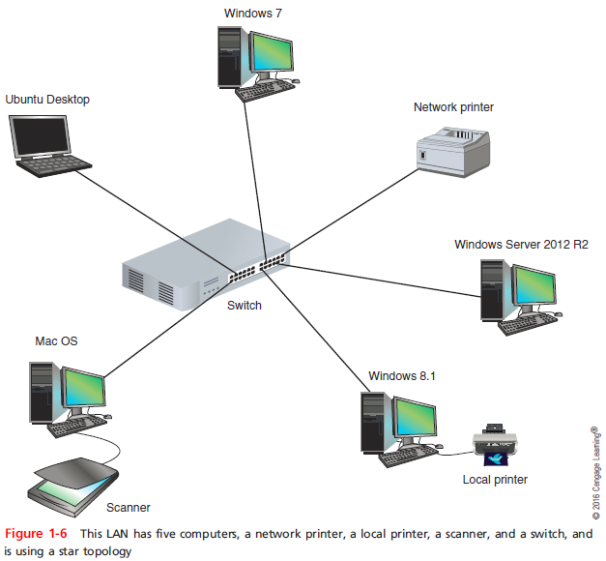
Networking Hardware and Physical Topologies
Notes:
Networking Hardware and Physical Topologies

Slide 21
LANs and Their Hardware
Local area network (LAN) - usually contained in a small space
Such as an office or building
Switch - receives incoming data from one of its ports and redirects it to another port or multiple ports
Will send the data to its intended destination
Star topology - all devices connect to one central device (usually a switch)
Network interface card (NIC) - a network port used to attach a device to a network
Notes:
LANs and Their Hardware
Local area network (LAN) - usually contained in a small space
Such as an office or building
Switch - receives incoming data from one of its ports and redirects it to another port or multiple ports
Will send the data to its intended destination
Star topology - all devices connect to one central device (usually a switch)
Network interface card (NIC) - a network port used to attach a device to a network

Slide 22
LANs and Their Hardware
A LAN can have several switches
Backbone - a central conduit that connects the segments (pieces) of a network
Might use higher transmission speeds and different cabling than network cables connected to computers
Three switches daisy-chained together in a single line is said to use a bus topology
However, each switch is connected to computers via a star topology, making it a star-bus topology
A topology that combines topologies is known as a hybrid topology
Notes:
LANs and Their Hardware
A LAN can have several switches
Backbone - a central conduit that connects the segments (pieces) of a network
Might use higher transmission speeds and different cabling than network cables connected to computers
Three switches daisy-chained together in a single line is said to use a bus topology
However, each switch is connected to computers via a star topology, making it a star-bus topology
A topology that combines topologies is known as a hybrid topology

Slide 23
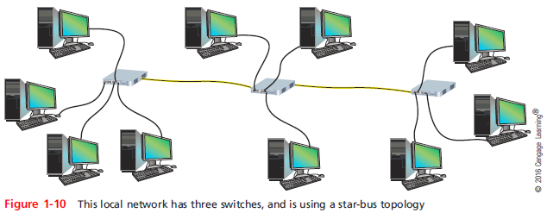
LANs and Their Hardware
Notes:
LANs and Their Hardware

Slide 24
LANs and Their Hardware
Router - a device that manages traffic between two or more networks
Can help find the best path for traffic to get from one network to another
Routers can be used in small home networks to connect the home LAN to the Internet
Industrial-grade routers can have several network ports, one for each network it connects to
Difference between router and switch:
Router is like a gateway between networks
Notes:
LANs and Their Hardware
Router - a device that manages traffic between two or more networks
Can help find the best path for traffic to get from one network to another
Routers can be used in small home networks to connect the home LAN to the Internet
Industrial-grade routers can have several network ports, one for each network it connects to
Difference between router and switch:
Router is like a gateway between networks

Slide 25
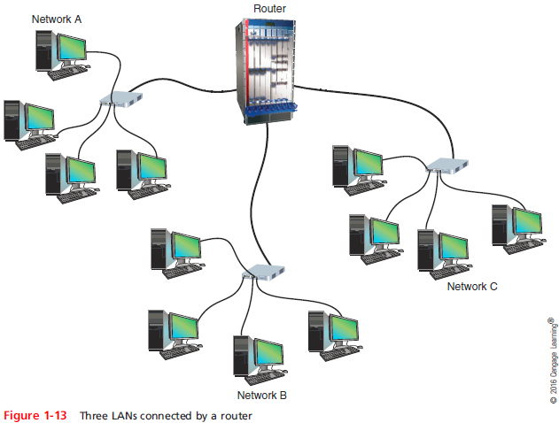
LANs and Their Hardware
Notes:
LANs and Their Hardware

Slide 26
MANs and WANs
Metropolitan area network (MAN) - a group of connected LANs in the same geographical area
Also known as a campus area network (CAN)
WAN (wide area network) - a group of LANs that spread over a wide geographical area
Internet is the largest and most varied WAN
MANs and WANs often use different transmission methods and media than LANs
PAN (personal area network) - smallest network
A network of personal devices
Notes:
MANs and WANs
Metropolitan area network (MAN) - a group of connected LANs in the same geographical area
Also known as a campus area network (CAN)
WAN (wide area network) - a group of LANs that spread over a wide geographical area
Internet is the largest and most varied WAN
MANs and WANs often use different transmission methods and media than LANs
PAN (personal area network) - smallest network
A network of personal devices

Slide 27
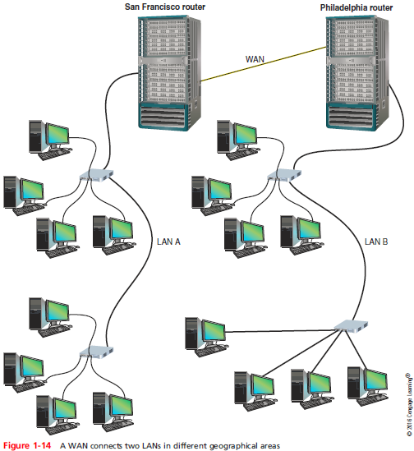
MANs and WANs
Notes:
MANs and WANs

Slide 28
The Seven-Layer OSI Model
OSI (Open Systems Interconnection) reference model - a seven-layer model developed to categorize the layers of communication
Developed by ISO in the 1980s
The layers are numbered in order, starting with Layer 1, the Physical layer at the bottom
Physical, Data Link, Network, Transport, Session, Presentation, Application
Notes:
The Seven-Layer OSI Model
OSI (Open Systems Interconnection) reference model - a seven-layer model developed to categorize the layers of communication
Developed by ISO in the 1980s
The layers are numbered in order, starting with Layer 1, the Physical layer at the bottom
Physical, Data Link, Network, Transport, Session, Presentation, Application

Slide 29
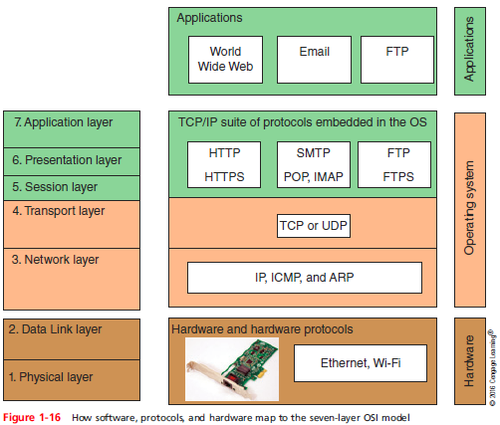
The Seven-Layer OSI Model
Notes:
The Seven-Layer OSI Model

Slide 30
Layer 7: Application Layer
Application layer - describes the interface between two applications, on separate computers
Application layer protocols are used by programs that fall into two categories:
Provide services to a user, such as a browser and Web server
Utility programs that provide services to the system, such as SNMP that monitor and gather information about network traffic
Payload - data that is passed between applications or utility programs and the OS
Notes:
Layer 7: Application Layer
Application layer - describes the interface between two applications, on separate computers
Application layer protocols are used by programs that fall into two categories:
Provide services to a user, such as a browser and Web server
Utility programs that provide services to the system, such as SNMP that monitor and gather information about network traffic
Payload - data that is passed between applications or utility programs and the OS

Slide 31
Layer 6: Presentation Layer
Presentation layer - responsible for reformatting, compressing, and/or encrypting data in a way that the receiving application can read
Example:
An email message can be encrypted at the Presentation layer by the email client or by the OS
Notes:
Layer 6: Presentation Layer
Presentation layer - responsible for reformatting, compressing, and/or encrypting data in a way that the receiving application can read
Example:
An email message can be encrypted at the Presentation layer by the email client or by the OS

Slide 32
Layer 5: Session Layer
Session layer - describes how data between applications is synched and recovered if messages don’t arrive intact at the receiving application
The Application, Presentation, and Session layers are intertwined
Often difficult to distinguish between them
Most tasks are performed by the OS when an application makes an API call to the OS
Application programming interface (API) call is the method an application uses when it makes a request of the OS
Notes:
Layer 5: Session Layer
Session layer - describes how data between applications is synched and recovered if messages don’t arrive intact at the receiving application
The Application, Presentation, and Session layers are intertwined
Often difficult to distinguish between them
Most tasks are performed by the OS when an application makes an API call to the OS
Application programming interface (API) call is the method an application uses when it makes a request of the OS

Slide 33
Layer 4: Transport Layer
Transport layer - responsible for transporting Application layer payloads from one application to another
Two main Transport layer protocols are:
TCP (Transmission Control Protocol) - makes a connection with the end host, checks whether data was received; called a connection-oriented protocol
UDP (User Datagram Protocol) - does not guarantee delivery by first connecting and checking whether data is received; called a connectionless protocol
Notes:
Layer 4: Transport Layer
Transport layer - responsible for transporting Application layer payloads from one application to another
Two main Transport layer protocols are:
TCP (Transmission Control Protocol) - makes a connection with the end host, checks whether data was received; called a connection-oriented protocol
UDP (User Datagram Protocol) - does not guarantee delivery by first connecting and checking whether data is received; called a connectionless protocol

Slide 34
Layer 4: Transport Layer
Protocols add their own control information in an area at the beginning of the payload (called a header)
Encapsulation - process of adding a header to the data inherited from the layer above
The Transport layer header addresses the receiving application by a number called a port number
If message is too large, TCP divides it into smaller messages called segments
In UDP, the message is called a datagram
Notes:
Layer 4: Transport Layer
Protocols add their own control information in an area at the beginning of the payload (called a header)
Encapsulation - process of adding a header to the data inherited from the layer above
The Transport layer header addresses the receiving application by a number called a port number
If message is too large, TCP divides it into smaller messages called segments
In UDP, the message is called a datagram

Slide 35
Layer 3: Network Layer
Network layer - responsible for moving messages from one node to another until reaches destination
IP adds its own Network layer header to the segment or datagram
The entire Network layer message is called a packet
IP address - assigned to each node on a network
Network layer uses it to uniquely identify each host
IP relies on several routing protocols to find the best route for a packet to take to reach destination
ICMP and ARP are examples
Notes:
Layer 3: Network Layer
Network layer - responsible for moving messages from one node to another until reaches destination
IP adds its own Network layer header to the segment or datagram
The entire Network layer message is called a packet
IP address - assigned to each node on a network
Network layer uses it to uniquely identify each host
IP relies on several routing protocols to find the best route for a packet to take to reach destination
ICMP and ARP are examples

Slide 36
Layer 2: Data Link Layer
Layers 2 and 1 are responsible for interfacing with physical hardware on the local network
Protocols at these layers are programmed into firmware of a computer’s NIC and other hardware
Type of networking hardware or technology used on a network determine the Link Layer protocol used
Ethernet and Wi-Fi are examples
The Link layer puts control information in a Link layer header and at the end of the packet in a trailer
Entire Link layer is called a frame
Notes:
Layer 2: Data Link Layer
Layers 2 and 1 are responsible for interfacing with physical hardware on the local network
Protocols at these layers are programmed into firmware of a computer’s NIC and other hardware
Type of networking hardware or technology used on a network determine the Link Layer protocol used
Ethernet and Wi-Fi are examples
The Link layer puts control information in a Link layer header and at the end of the packet in a trailer
Entire Link layer is called a frame

Slide 37
Layer 2: Data Link Layer
MAC (Media Access Control) address - hardware address of the source and destination NICs
Also called a physical address, hardware address, or Data Link layer address
Embedded on every network adapter and are considered short-range addresses that can only find nodes on the local network
Notes:
Layer 2: Data Link Layer
MAC (Media Access Control) address - hardware address of the source and destination NICs
Also called a physical address, hardware address, or Data Link layer address
Embedded on every network adapter and are considered short-range addresses that can only find nodes on the local network

Slide 38
Layer 1: Physical Layer
Physical layer - simplest layer and is responsible for sending bits via a wired or wireless transmission
Can be transmitted as:
Wavelengths in the air
Voltage on a copper wire
Light (via fiber-optic cabling)
Notes:
Layer 1: Physical Layer
Physical layer - simplest layer and is responsible for sending bits via a wired or wireless transmission
Can be transmitted as:
Wavelengths in the air
Voltage on a copper wire
Light (via fiber-optic cabling)

Slide 39
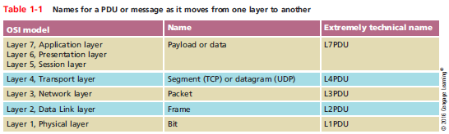
Protocol Data Unit or PDU
Protocol data unit (PDU) - the technical name for a group of bits as it moves from one layer to the next and from one LAN to the next
Technicians loosely call this group of bits a message or a transmission
Notes:
Protocol Data Unit or PDU
Protocol data unit (PDU) - the technical name for a group of bits as it moves from one layer to the next and from one LAN to the next
Technicians loosely call this group of bits a message or a transmission

Slide 40
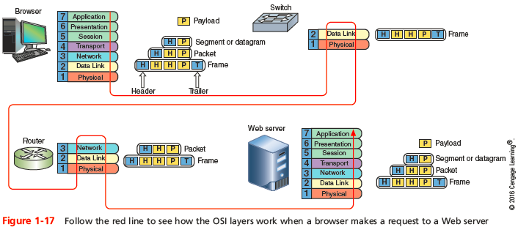
Summary of How the Layers Work Together
Notes:
Summary of How the Layers Work Together

Slide 41
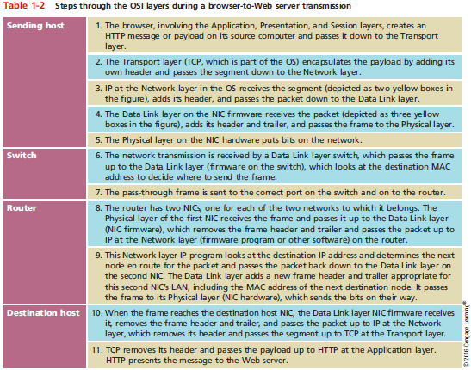
Summary of How the Layers Work Together
Notes:
Summary of How the Layers Work Together

Slide 42
Staying Safe When Working with Networks and Computers
Network and computer technicians need to know how to protect themselves
As wells as protect sensitive electronic components
This section takes a look at some best practices for safety
Notes:
Staying Safe When Working with Networks and Computers
Network and computer technicians need to know how to protect themselves
As wells as protect sensitive electronic components
This section takes a look at some best practices for safety

Slide 43
Emergency Procedures
Know the best escape route or emergency exit
Fire Suppression Systems - have a fire suppression system in the data center that includes:
Emergency alert system
Portable fire extinguishers
Emergency power-off switch
Suppression agent
Fail Open or Fail Close - does the security system allow access during a failure (fail open) or deny access during the failure (fail close)
Notes:
Emergency Procedures
Know the best escape route or emergency exit
Fire Suppression Systems - have a fire suppression system in the data center that includes:
Emergency alert system
Portable fire extinguishers
Emergency power-off switch
Suppression agent
Fail Open or Fail Close - does the security system allow access during a failure (fail open) or deny access during the failure (fail close)

Slide 44
Emergency Procedures
Material Safety Data Sheet (MSDS) - explains how to properly handle substances such as chemical solvents and how to dispose of them
Includes information such as physical data, toxicity, health effects, first aid, storage, shipping, disposal, and spill procedures
Notes:
Emergency Procedures
Material Safety Data Sheet (MSDS) - explains how to properly handle substances such as chemical solvents and how to dispose of them
Includes information such as physical data, toxicity, health effects, first aid, storage, shipping, disposal, and spill procedures

Slide 45
HVAC Systems
Heating, ventilation, and air conditioning (HVAC) system - controls the environment in a data center
Including the temperature, humidity, airflow, and air filtering
HVAC system must provide acceptable temperature and humidity ranges for devices that might overheat or fail due to high humidity
HVAC systems and network cabling often occupy the space above the ceiling or below the floor in a data center
Called the plenum
Notes:
HVAC Systems
Heating, ventilation, and air conditioning (HVAC) system - controls the environment in a data center
Including the temperature, humidity, airflow, and air filtering
HVAC system must provide acceptable temperature and humidity ranges for devices that might overheat or fail due to high humidity
HVAC systems and network cabling often occupy the space above the ceiling or below the floor in a data center
Called the plenum

Slide 46
Protecting Against Static Electricity
Computer components are grounded inside a computer case
Sensitive electronic components can be damaged by electrostatic discharge (ESD)
Static electricity can cause two types of damage:
Catastrophic failure - destroyed beyond use
Upset failure - shorten the life of a component
Notes:
Protecting Against Static Electricity
Computer components are grounded inside a computer case
Sensitive electronic components can be damaged by electrostatic discharge (ESD)
Static electricity can cause two types of damage:
Catastrophic failure - destroyed beyond use
Upset failure - shorten the life of a component

Slide 47
Protecting Against Static Electricity
Before touching a component, ground yourself by:
Wearing an ESD strap around your wrist that clips onto the chassis or computer case
Touching the case before touching any component inside the case
Storing a component inside an antistatic bag
In addition to protecting against ESD, always shut down and unplug a computer before working inside it
Notes:
Protecting Against Static Electricity
Before touching a component, ground yourself by:
Wearing an ESD strap around your wrist that clips onto the chassis or computer case
Touching the case before touching any component inside the case
Storing a component inside an antistatic bag
In addition to protecting against ESD, always shut down and unplug a computer before working inside it

Slide 48
Installation Safety
Lifting Heavy Objects - follow these guidelines:
Decide which side of object to face so load is most balanced
Stand close to the object with your feet apart
Keep your back straight, bend knees and grip load
Lift with your legs, arms, and shoulders (not your back or stomach)
Keep the load close to your body and avoid twisting your body while you’re holding it
To put the object down, keep your back as straight as possible and lower object by bending your knees
Notes:
Installation Safety
Lifting Heavy Objects - follow these guidelines:
Decide which side of object to face so load is most balanced
Stand close to the object with your feet apart
Keep your back straight, bend knees and grip load
Lift with your legs, arms, and shoulders (not your back or stomach)
Keep the load close to your body and avoid twisting your body while you’re holding it
To put the object down, keep your back as straight as possible and lower object by bending your knees

Slide 49
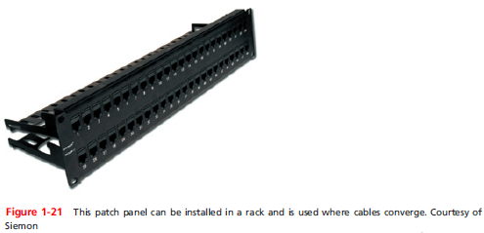
Installation Safety
Rack Installations - switches, routers, servers, and patch panels can be installed in racks
Follow device manufacturer’s guidelines for requirements for the rack and the direction for installation
Notes:
Installation Safety
Rack Installations - switches, routers, servers, and patch panels can be installed in racks
Follow device manufacturer’s guidelines for requirements for the rack and the direction for installation

Slide 50
Installation Safety
General directions for safely installing rack-mountable devices:
Engage brakes on rack wheels, if applicable
Wear an ESD strap
Place the device in the rack for good airflow
Device must be well grounded
Pay attention to tools as you work so they don’t accidentally fall into a rack of expensive equipment
Install fan trays so that air flows in the same direction as the fans inside the device
Notes:
Installation Safety
General directions for safely installing rack-mountable devices:
Engage brakes on rack wheels, if applicable
Wear an ESD strap
Place the device in the rack for good airflow
Device must be well grounded
Pay attention to tools as you work so they don’t accidentally fall into a rack of expensive equipment
Install fan trays so that air flows in the same direction as the fans inside the device

Slide 51
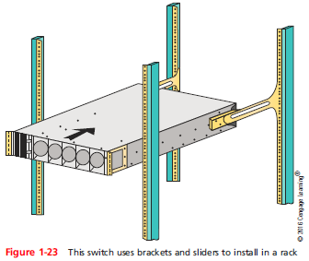
Installation Safety
Notes:
Installation Safety

Slide 52
Electrical and Tool Safety in Data Centers
Electrical and tool safety is generally regulated by OSHA (Occupational Safety and Health Administration)
OSHA guidelines when using power tools:
Wear personal protective equipment (PPE)
Keep all tools in good condition and properly store tools not in use
Use the right tool for the job and operate the tool according to the manufacturer’s instructions
Watch out for trip hazards, so you and others don’t stumble on a tool or cord
Notes:
Electrical and Tool Safety in Data Centers
Electrical and tool safety is generally regulated by OSHA (Occupational Safety and Health Administration)
OSHA guidelines when using power tools:
Wear personal protective equipment (PPE)
Keep all tools in good condition and properly store tools not in use
Use the right tool for the job and operate the tool according to the manufacturer’s instructions
Watch out for trip hazards, so you and others don’t stumble on a tool or cord

Slide 53
Troubleshooting Network Problems
Troubleshooting steps used by most expert networking troubleshooters:
Identify problem
Gather information
Identify symptoms
Question users
Determine if anything has changed
Establish theory of probable cause
Question the obvious
Notes:
Troubleshooting Network Problems
Troubleshooting steps used by most expert networking troubleshooters:
Identify problem
Gather information
Identify symptoms
Question users
Determine if anything has changed
Establish theory of probable cause
Question the obvious

Slide 54
Troubleshooting Network Problems
Troubleshooting steps (cont’d)
Test theory to determine cause
If theory confirmed, determine next steps
If theory not confirmed, establish new theory or escalate
Establish action plan
Implement solution or escalate the problem
Verify full functionality
Implement preventative measures if applicable
Document findings, actions, outcomes
Notes:
Troubleshooting Network Problems
Troubleshooting steps (cont’d)
Test theory to determine cause
If theory confirmed, determine next steps
If theory not confirmed, establish new theory or escalate
Establish action plan
Implement solution or escalate the problem
Verify full functionality
Implement preventative measures if applicable
Document findings, actions, outcomes

Slide 55
Summary
Networks provide a wide range of services, including client-server applications, file and print services, and communications services
File and print services enable multiple users to share data, storage areas, and printers
Traditional peer-to-peer networks are usually simple and inexpensive to set up
The client-server model for access control relies on a centrally administered server using a NOS that manages shared resources for multiple clients
More complex and expensive to install
Notes:
Summary
Networks provide a wide range of services, including client-server applications, file and print services, and communications services
File and print services enable multiple users to share data, storage areas, and printers
Traditional peer-to-peer networks are usually simple and inexpensive to set up
The client-server model for access control relies on a centrally administered server using a NOS that manages shared resources for multiple clients
More complex and expensive to install

Slide 56
Summary
A LAN is a network of computers and other devices that can directly address all other nodes
In a star topology, all computers and network devices connect to one central device
A backbone is a central conduit that connects parts of a network and might use the bus topology
A router manages traffic between two or more LANS
LANS can be interconnected to form WANS, which traverse longer distances in two or more geographical areas
Notes:
Summary
A LAN is a network of computers and other devices that can directly address all other nodes
In a star topology, all computers and network devices connect to one central device
A backbone is a central conduit that connects parts of a network and might use the bus topology
A router manages traffic between two or more LANS
LANS can be interconnected to form WANS, which traverse longer distances in two or more geographical areas

Slide 57
Summary
The seven layers of the OSI model are Application, Presentation, Session, Transport, Network, Data Link, and Physical
At Layers 7,6, and 5, data and its control information is known as the payload
A message at the Transport layer is called a segment in TCP and a datagram in UDP
An IP transmission is called a packet
A message at the Data Link layer is called a frame
Some switches operate at the Data Link layer and routers operate at the Network layer
Notes:
Summary
The seven layers of the OSI model are Application, Presentation, Session, Transport, Network, Data Link, and Physical
At Layers 7,6, and 5, data and its control information is known as the payload
A message at the Transport layer is called a segment in TCP and a datagram in UDP
An IP transmission is called a packet
A message at the Data Link layer is called a frame
Some switches operate at the Data Link layer and routers operate at the Network layer

Slide 58
Summary
A fire suppression system can include an emergency alert system, portable fire extinguishers, an emergency power-off switch, and suppression agents
HVAC systems are responsible for controlling humidity and temperature in a data center
When working with sensitive components, protect against ESD by using an ESD strap
Troubleshooting problems and their solutions are documented in a call tracking system
Notes:
Summary
A fire suppression system can include an emergency alert system, portable fire extinguishers, an emergency power-off switch, and suppression agents
HVAC systems are responsible for controlling humidity and temperature in a data center
When working with sensitive components, protect against ESD by using an ESD strap
Troubleshooting problems and their solutions are documented in a call tracking system

